Slide 1
e-commerce shopping website

Slide 2

Target Audience/what we sell
The target audience we chose was the general populous, we chose this as our target audience as it gave us a greater reach of the commercial market. We decided that a good website is dictated by how many visitors (hits) it received over a period of time; due to this we decided to try to reach the largest market open to us as to attract more people to the website; therefore making it more popular and successful as a website.
We will sell literally everything from furniture to sports equipment.

Slide 3

Logo
We chose this logo because we think it fits the aesthetics of the website and has a stylish and simple appeal to the target audience. We chose the name Coles because it gives a feeling of family unity and we didn’t have a logo from the client so we made our own.

Slide 4
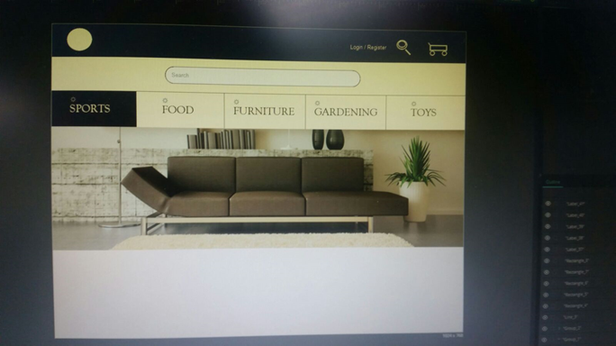
Header
The header will include login for previous members as to make the experience on the website smoother and feel fluid so the user experience is better.
The header will also have a register button as so the environment of the site feels more welcoming and the user experience is better.
The header will also include the option to open a search bar so the user will have instant access to whatever they want on the site.
On the header there will also be a checkout option, this is include here so its easier for the user to see but also as it flows nicely with the aesthetics of the site.
The header will be a very pleasant shade of brown with all icons being light yellow. We chose this colour pallet as it has a very premium feel so the people visiting the site will feel as if they are buying quality.

Slide 5
Search bar
The search bar will open when the icon at the top is clicked. It will open just below the header as so its easy for the user to see and feels more fluid. The search bar will be surrounded in very light yellow to match that of the icons displayed on the header, we chose this to make the site look more uniformed. The search bar will be rounded with a brown border to give it a more appealing aesthetic.

Slide 6

Nav bar
The nav bar will be comprised of 5 sections sports, food, furniture, gardening and toys, these sections will have drop down menus for more specific sections.
It is styled in the same way as the header but in reverse, where as the main colour is brown for when that section is active with yellow text. Usually the sections will be yellow with brown text to meet the aesthetic of the website. We did this to make the website seem more uniformed and professional looking. Each section will have a border to match the colour of the font.

Slide 7
Picture
Below the nav bar will be a carousel of pictures showing the most poplar items. We do this to break up the static feel of the website as if different shapes are used the site has a more organic feel.

Slide 8
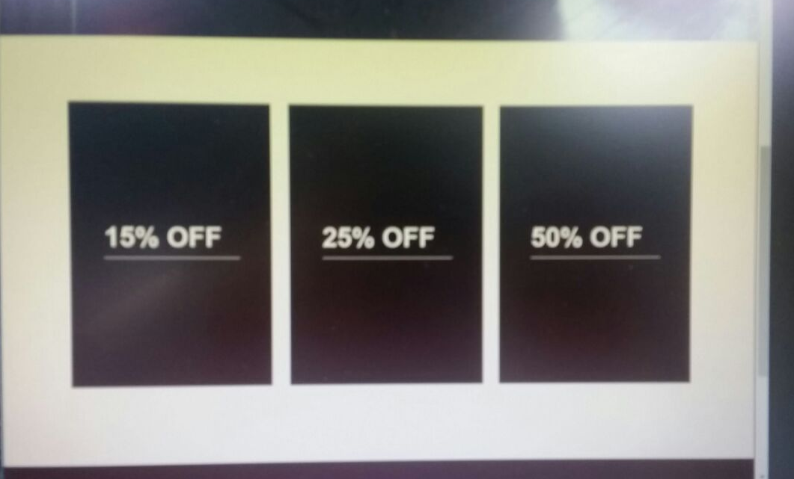
Special offers
There will be 3 special offers on display below the picture of the home page. The special offers will be neatly stacked next to each other with a picture of the product that is being discounted. The idea behind this is that when the customer first loads up the page the first thing they will see is an appetising picture of a random product available to buy on the e-commerce website and once the customer scrolls down they will already have an idea of the quality of products available to purchase, this will get them thinking about discounts and what sort of deals they can get. The more someone thinks about a product they like, the more likely they are to buy it.

Slide 9
Footer
In the footer we have 14 sections which are:
Refunds
Returns
Jobs with us
Report an issue
Legal
Charity work
Donations
Speak with our staff
Our promise
About us
Contact us
Stores
Commonly asked questions
Reviews
There will also be 3 social media link to the right below the third column.
There will then be a line that separates the links from the copyright and a logo.
The footer will have a brown and yellow pallet to it to make the footer fit the scheme of website; giving the website a more uniformed look.

